Slide 1
My INMED International Healthcare Experience
Enter you name, title, demographics, contact info
Notes:
INMED provides this template to you to to ease the process of communicating about your experiences. You can add as many new pages, photos and content as you wish. At the end are included a few slide about INMED opportunities that your friends and colleagues may wish to learn about. How can we improve this template in the future? Please share any feedback at office@inmed.us or 816-444-6400. Thank you!

Slide 2
Location
Describe the health of the community of your INMED Training Site. Include community demographics, health behavior, and health problems, and how these are connected with income, education, and access to healthcare.

Slide 3
Services Provided
Describe the healthcare services provided at your INMED Training Site. How are these influenced by funding, staffing, and community acceptability?

Slide 4
My Role
Describe your role at this Training Site, including an explanation of your responsibilities and typical daily activities.

Slide 5
A Powerful Experience
Please share a specific, personal story from your experience that might inspire someone to engage in healthcare for forgotten people.

Slide 6
Personal Struggles
What kind of personal struggles or challenges did you face during this experience? These may include, for example, cultural shock, cultural misunderstandings, ethical dilemmas, language barriers, and adaptation to low-resource healthcare. Cite a particular example that was vexing to you and what would be potential solutions to this situation.

Slide 7
Next Time
Imagine yourself beginning a new healthcare work in a similar community. How would you begin? What interventions would you advocate first?

Slide 8
Global Health Perspective
What is one of the greatest threats to world health today? You can focus on diseases, behaviors, or policies. Describe what actions could effectively combat this threat.

Slide 9
Your Motivation
What personally motivates you to promote healthcare for marginalized people?

Slide 10
Your Recommendations
Many healthcare professionals are enamored with the possibility of serving forgotten people. Yet relatively few ultimately make this their major career tract. What steps can you recommend to help turn this dream into a reality?

Slide 11
Forgotten People
Notes:
http://www.flickr.com/photos/hdptcar/537308554/sizes/l/in/photostream/
http://flickrhivemind.net/Tags/centralafricanrepublic,children/Interesting
2012-10-01

Slide 12
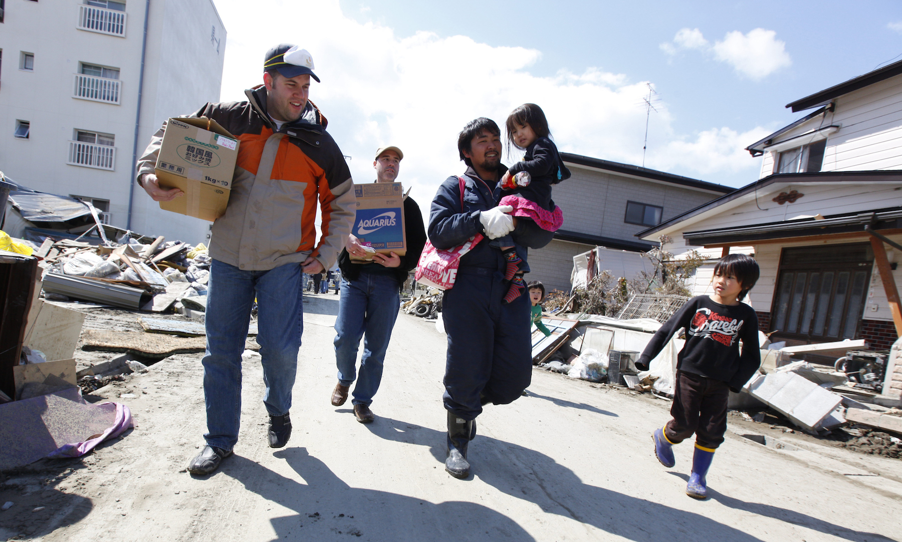
Our Needy World

Slide 13
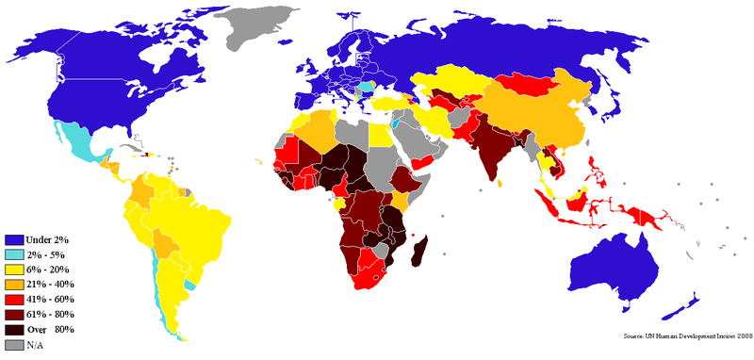
Forgotten People Afar
Nations of Poverty
Notes:
Source
http://en.wikipedia.org/wiki/List_of_countries_by_percentage_of_population_living_in_poverty
2012-09-29

Slide 14
Forgotten People At Home
Notes:
Source
http://chieforganizer.org/wp-content/uploads/2011/09/Childern-of-the-Gulf-American-Poverty1.bmp
2012-09-29

Slide 15
“We want to serve!”

Slide 16
“But we have questions”
Where could we serve?
What organization to choose?
How to prepare?
What skills do we need?
How to pay for it?
How does family fit in?
What about language?

Slide 17
“Equipping healthcare professionals & students to serve the forgotten”

Slide 18
Each spring in Kansas City, Missouri

Slide 19
Professional Certificate Courses
Ultrasound
Newborn Resuscitation
Complicated Obstetrics
Diseases of Poverty
International HIV Medicine
International Public Health
Cross-Cultural Skills
Disaster Management
And more!

Slide 20
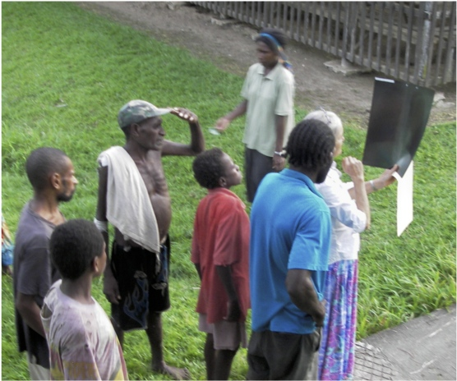
Service-Learning/Rotations in Medicine, Nursing, and Public Health
Asia
Bangladesh
China
India
Macau
Pakistan
Philippines
PNG
Russia
Africa
Angola
Cameroon
Ethiopia
Ghana
China
Kenya
South Africa
Tanzania
Uganda
Zambia
Kudjip Nazarene Hospital, Papua New Guinea

Slide 21
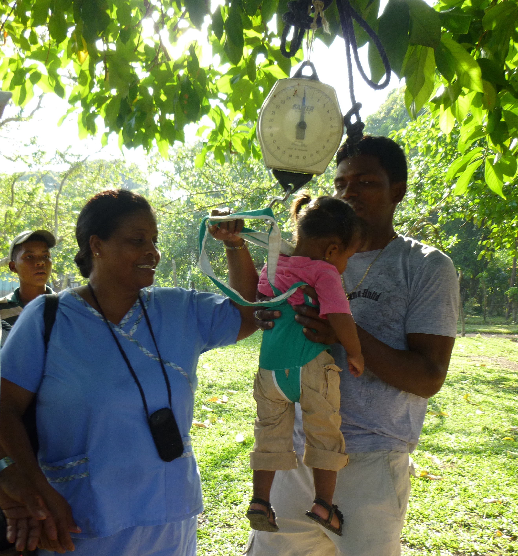
Service-Learning/Rotations in Medicine, Nursing and Public Health
Americas
Dominican Rep
Ecuador
Guatemala
Haiti
Honduras
USA
Middle East
Jordan
UAE
Clinica Evangelica Morava,
Honduras

Slide 22
Earn Esteemed Credentials

Slide 23
www.inmed.us
2340 E. Meyer Blvd, Building 1, Suite 338
Kansas City MO 64132 816-444-6400 ~ office@inmed.us

